Slide 1
Differentiation of mild cognitive impairment using an entorhinal cortex-based test of virtual reality navigation
Journal：BRAIN
Impact factor：11.814

Slide 2
Introduction
1. To date, all interventional trials aimed at slowing the progression of Alzheimer’s disease have failed.
2. Reasons of 1.:
(1) problems in identifying the initial stages of Alzheimer’s disease
(2) the lack of translatable outcome measures for treatment effects
3. Solution: Detection of Alzheimer’s disease-related changes in entorhinal cortex (EC，内嗅皮质层) function.

Slide 3
Introduction
4. The work of other researchers:
(1) Degeneration of the EC is a critical initial stage of typical Alzheimer’s disease.
(2) EC is involved in spatial navigation.
(3) Sensory characteristics of objects appear to be represented in the anterolateral EC(alEC, 前外侧EC).
(4) Representations of scenes and current location based upon self-motion are represented in the posteromedial EC(pmEC, 后内侧EC).
(5) Within the EC, the medial EC (mEC, 内侧EC) is considered to be particularly involved in navigation.
(6) Remembering the spatial conﬁguration of an environment and the objects/contents within it is dependent upon the hippocampus(海马体).
(7) CSF(脑脊液) tau (tau蛋白)and CSF amyloid (淀粉样蛋白) are biomarkers of Alzheimer’s disease.

Slide 4
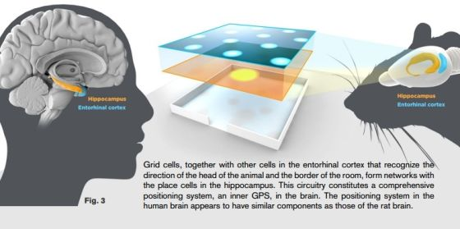

Slide 5
Materials and methods
1. Participants
(1) Patients with MCI (n=45)
MCI+, n=12
MCI-, n=14
The rest, n=19
(2) Healthy control subjects, (n=41)
MCI: mild cognitive impairment(轻度认知障碍)
Thresholds for positive: CSF amyloid<550pg/ml, CSF tau >375pg/ml with a CSF tau: amyloid ratio of >0.8

Slide 6
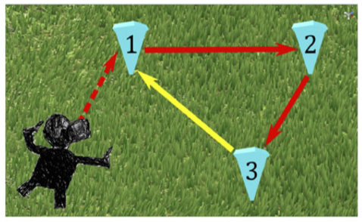
Materials and methods
2. The immersive virtual reality path integration task
(1) HTC Vive, Unity game engine, Steam VR software, MSI VR One backpack laptop, 3.5m*3.5m space
(2) Rules:
Red arrows indicate the guided sequence along two sides of the triangle. The yellow arrow indicates the return path.
Only one cone was visible at a time, upon reaching a blue cone it disappeared and the next one in the sequence appeared.
An auditory stimulus was presented with a cone’s appearance prompting participants toward the next cone’s location.
Upon reaching cone 3, participants will be asked to walk back to their remembered location of cone 1 (cone 1 won’t appear again).

Slide 7
Materials and methods
(2) Rules(续):
Return conditions applied when attempting to return to the location of cone 1 only.
Three return conditions were used: condition A, no environmental change (Fig. D); condition B, removal of boundary cues (Fig. E); and condition C, removal of surface detail (Fig. F).
Each return condition was presented three times per environment, return conditions presented pseudo-randomly, nine trials conducted within each of the three environments, totalling 27 trials per participant.
Pre-trial practice sessions consisted of 20s of habituation to the iVR environment. Following habituation, participants performed ﬁve practice trials, where cone 1 was re-presented at the end of each trial.
Notes:
Three return conditions 作用是 the absence of local landmarks ensured EC-grid cell dependent strategies rather than striatal-mediated landmark-based navigation

Slide 8
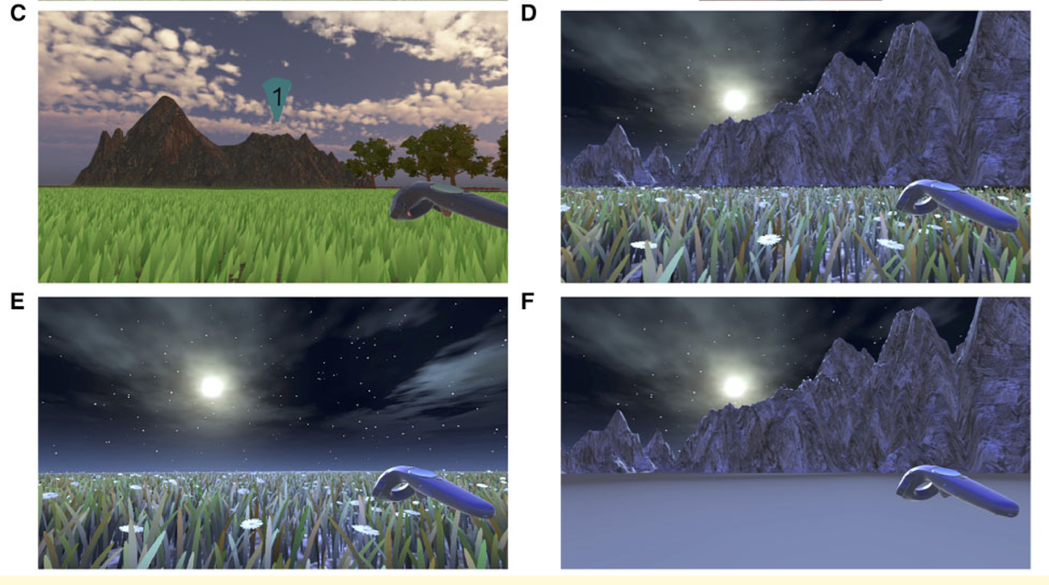
Materials and methods

Slide 9
Materials and methods
(3) Outcome measure:
Absolute distance error
= Euclidean distance between estimated and actual location of cone 1
Proportional linear errors
= Euclidean distance travelled between cone 3 and the participant’s estimated location of cone 1 compared to the distance between cone 3 and actual location of cone 1
Proportional angular errors
=the accuracy of performed rotation at cone 3 toward the participant’s estimated location of cone 1 compared to the optimal
rotation required to align with cone 1

Slide 10
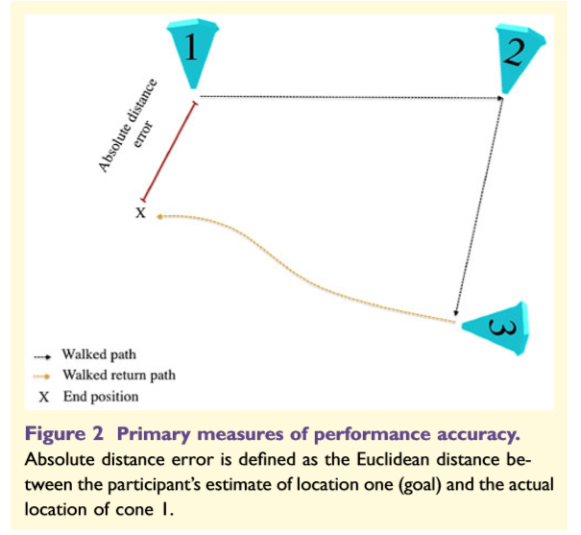
Materials and methods

Slide 11
Materials and methods
3. MRI (核磁共振)acquisition and analysis
(1) Aim: To investigate the relationship between EC subﬁeld volume and performance in navigational tasks.
(2) Software: ITK-SNAP, Freesurfer 6.0
(3) Field:
whole EC
alEC
pmEC
hippocampus
posterior cingulate cortex (PCC, 后扣带回皮质)
isthmus of cingulate cortex(扣带回皮质层沟)

Slide 12
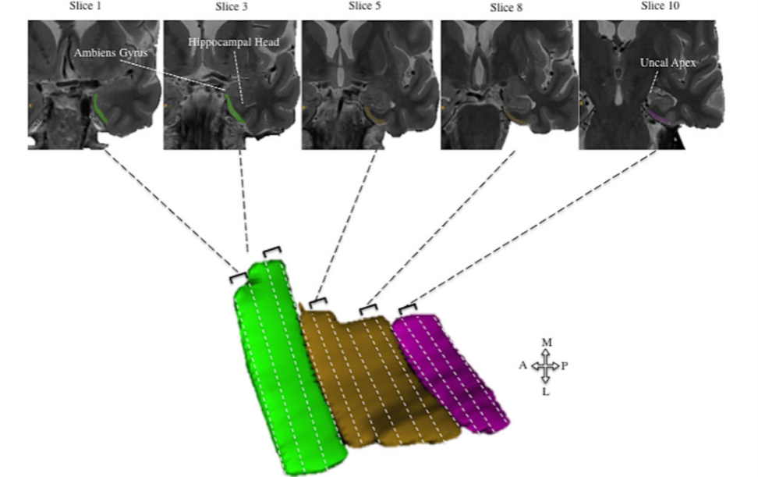
Materials and methods

Slide 13
Materials and methods
4. Comparator neuropsychological tests
(1) Free and Cued Selective Reminding Test (FCSRT)
(2) Rey ﬁgure recall (RFR)
(3) Trail Making Test B (TMT-B)
(4) Digit Symbol test (DST)
(5) 4MT
(6) ACE-R
(7) National Adult Reading Test (NART)

Slide 14
Result
1. Demographics and neuropsychological tests
(1) No signiﬁcant differences in age, gender, or years in education were observed between all MCI and healthy control subjects, or between MCI+ and MCI-.
(2) MCI group as a whole exhibited signiﬁcantly more errors in all neuropsychological tests compared to healthy control subjects.
(3) No difference between MCI+ and MCI- were observed.

Slide 15
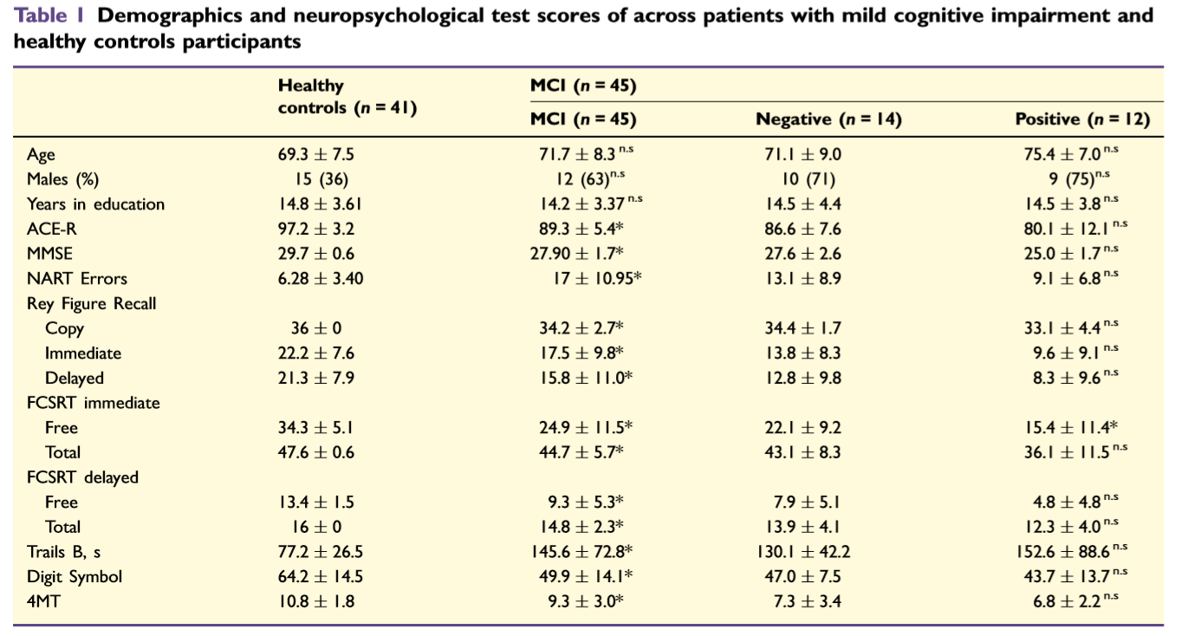
Result

Slide 16
Result
2. Immersive virtual reality path integration task
(1)Neither gender, years in education or age were predictive of absolute distance error.
(2) The MCI group as a whole exhibited signiﬁcantly larger absolute distance errors than the healthy control group.
(2) MCI+ patients exhibited signiﬁcantly larger absolute distance errors compared to MCI- patients.
(4) Similar effects were observed in proportional linear errors between healthy control subjects and total MCI group but were not observed in proportional angular error.
(3) Absolute distance error was positively correlated with CSF total tau(tau蛋白) and negatively associated with CSF amyloid-β(β淀粉样蛋白).

Slide 17
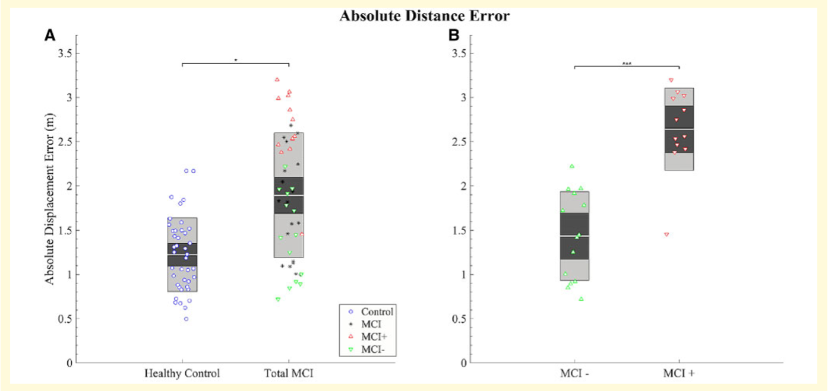
Result

Slide 18
Result
3. Effect of return condition on path integration
(1) No main effects of return condition was observed on absolute distance error between healthy control and total MCI groups, or between MCI+ and MCI- groups.
(2) For proportional angular errors, a trend toward an interaction between biomarker status (MCI+ versus MCI-) and return conditions B and C was observed.

Slide 19
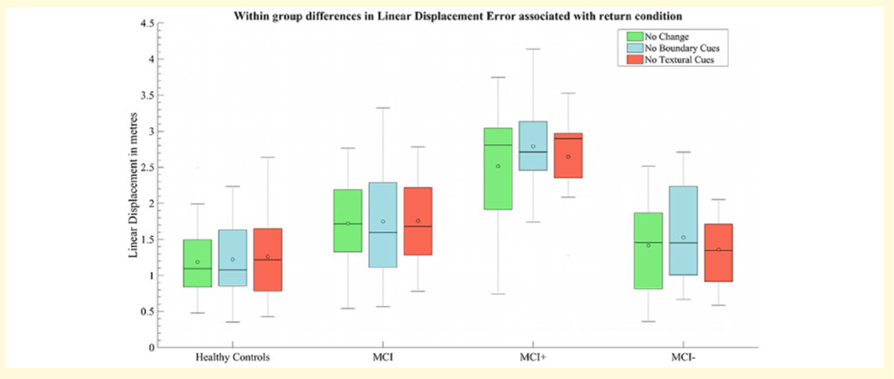
Result

Slide 20
Result
4. Group differences in MRI volumetry and association with path integration performance
(1) Across healthy control subjects and total MCI, only the volumetric difference of hippocampus, EC and pmEC were observed.
(2) Signiﬁcant negative associations were observed across all participants between absolute distance errors and both total EC volumes and pmEC volumes.

Slide 21
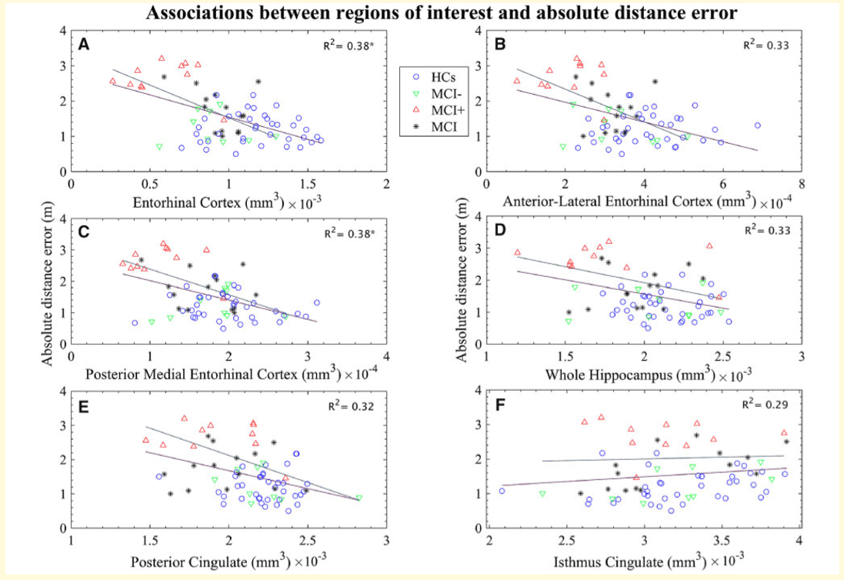
Result

Slide 22
Result
5. Receiver operating curves and classiﬁcation accuracy
(1) For the classification of total MCI patients form healthy control subjects, absolute distance error was associated with an AUC of 0.82
(2) Classiﬁcation accuracy of MCI+ from MCI- using absolute distance error was very high(AUC = 0.9).

Slide 23
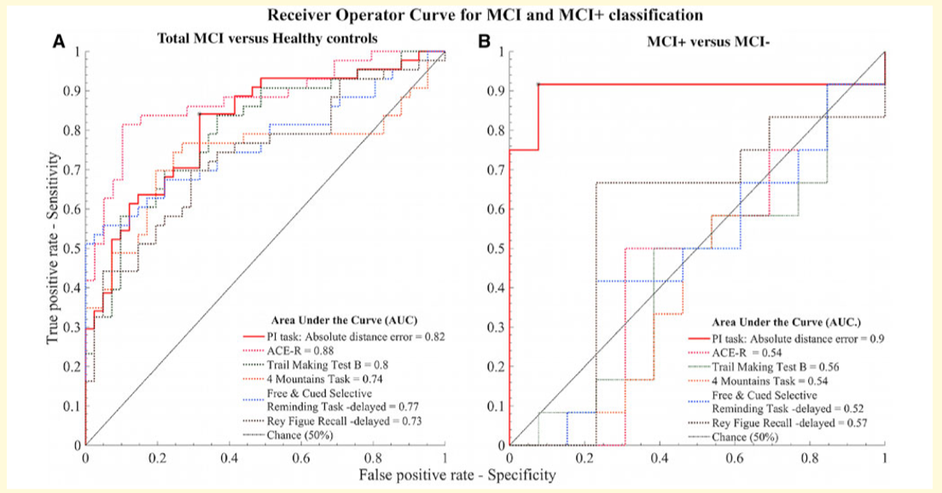
Result

Slide 24
Conclusion
1. MCI+ patients exhibited larger errors in the navigation task than MCI- patients, whose performance did not signiﬁcantly differ from healthy controls participants.
2. Signiﬁcant negative associations were observed across all participants between absolute distance errors and both total EC volumes and pmEC volumes.
3. Performance on an EC-based iVR path integration task is sensitive and speciﬁc for prodromal Alzheimer’s disease, with greater classiﬁcation accuracy than that of a battery of current ‘gold standard’ cognitive tests.

Slide 25
Conclusion
4. Limitations
(1) The sample size of both MCI+(n=12) and MCI(n=26) groups is small.
(2) The space (3.5m*3.5m) of iVR is small.

